Slide 1

Distributed & Cloud Computing
Welcome
Sukkur IBA University
Week – 07
Lecture – 13&14
Your Facilitator, Adil Khan

Slide 2
Kubernetes

Slide 3
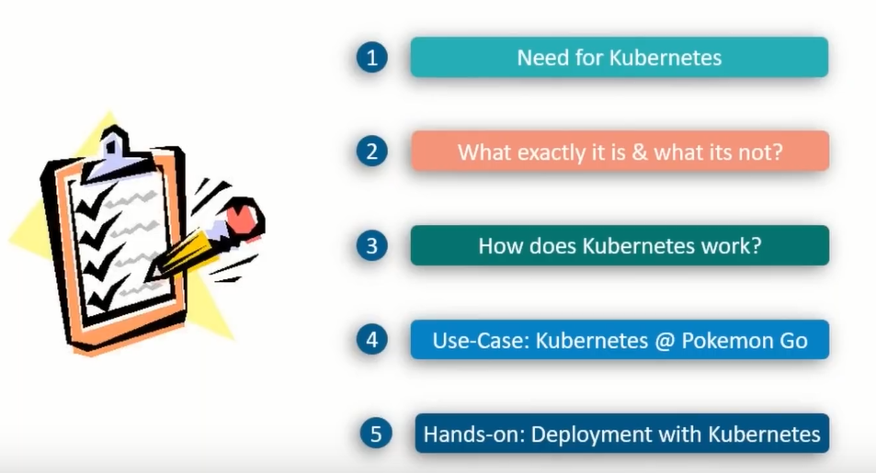
Kubernetes Topics

Slide 4
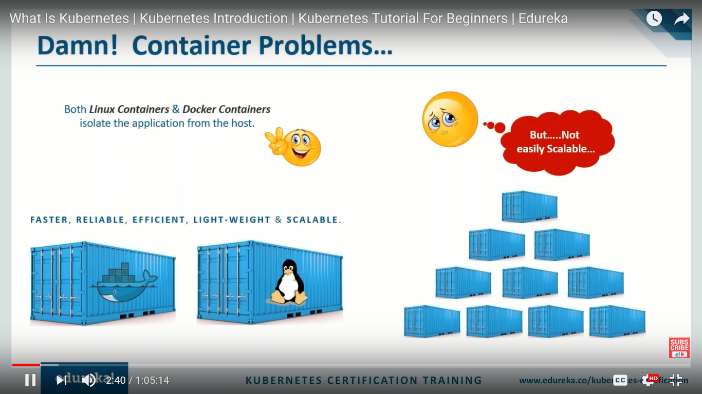
Container Problems….

Slide 5
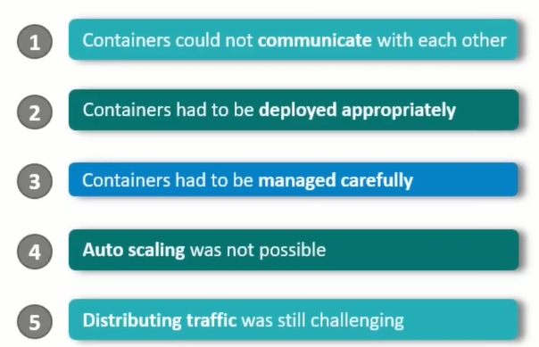
Problems with scaling up the containers

Slide 6
So what we need??

Slide 7
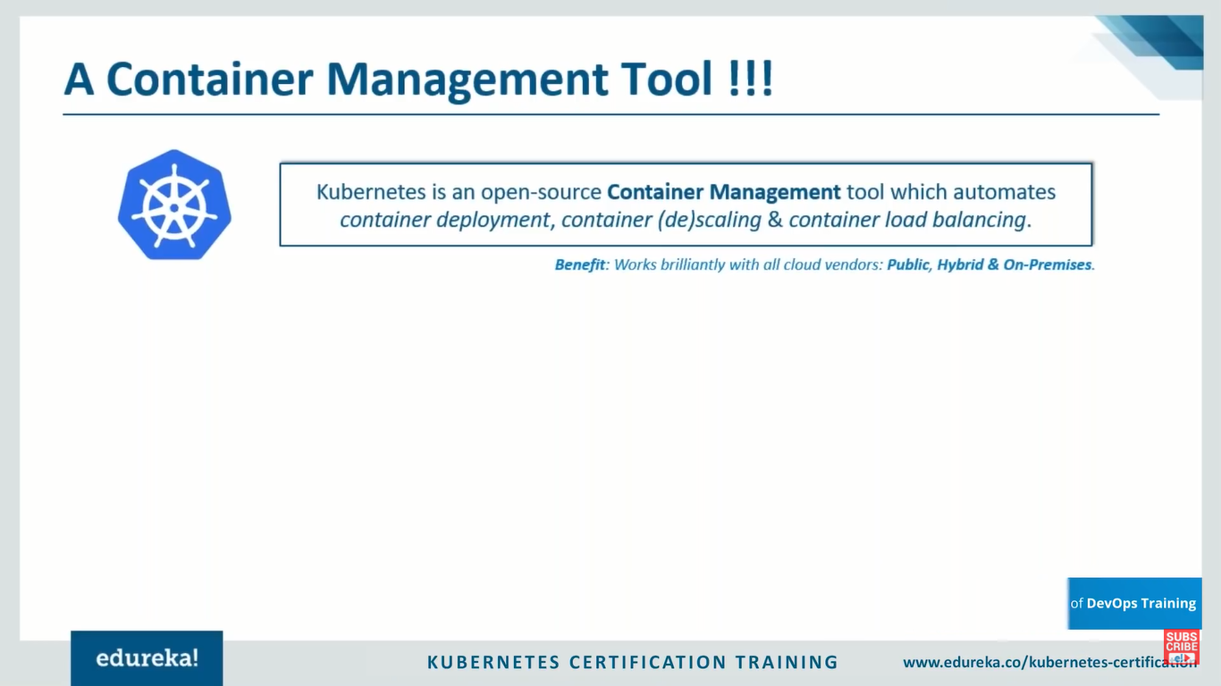
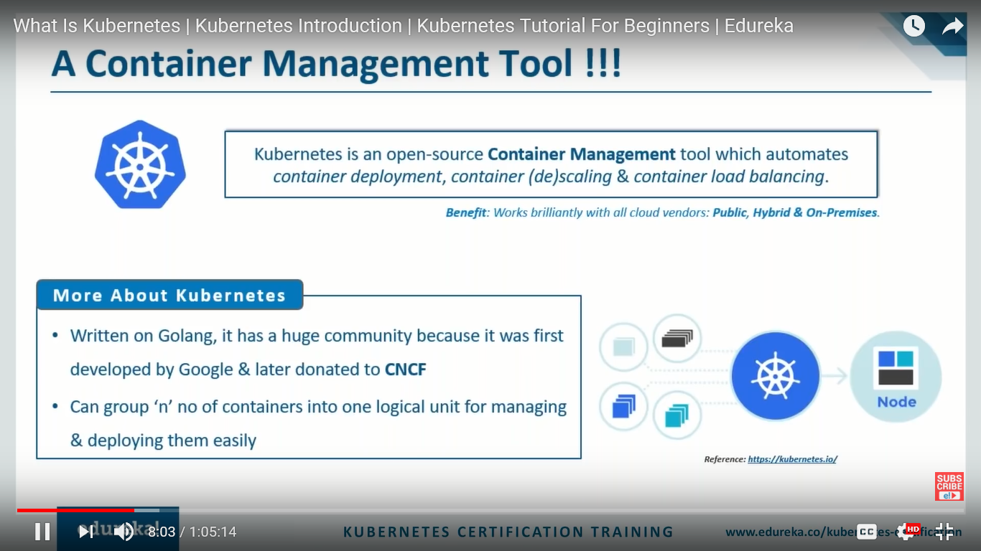
A Container Management Tool
Notes:
Cloud Native Computing Foundation (CNCF)

Slide 8
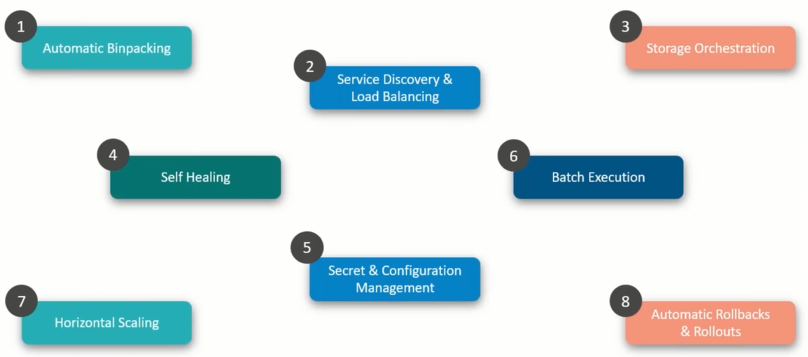
Features of Kubernetes
Notes:
1. The bin packing problem is an optimization problem, in which items of different sizes must be packed into a finite number of bins or containers, each of a fixed given capacity, in a way that minimizes the number of bins used.
2. No worry about networking and communication
3. Mount storage systems (local, NFS, Cloud, etc)
4. Self healing. Container fails restart it. Same with node failure healing on other node.
5. No need to rebuild entire image or restart
6. Batch Execution:

Slide 9
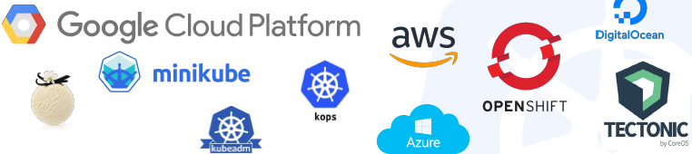
Why choose Kubernetes?
Develop anywhere, Deploy anywhere
Focus on containers/apps, not on the infrastructure
It’s made in parts that are exchangeable and optimizable
Canary deployments, Rolling Updates, Events and more
Relies on years of experience from Google’s production system - Borg
It is being actively developed

Slide 10
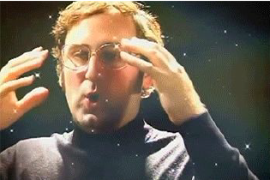
Most Importantly...
Use the SAME API across bare metal and EVERY cloud provider!!!

Slide 11
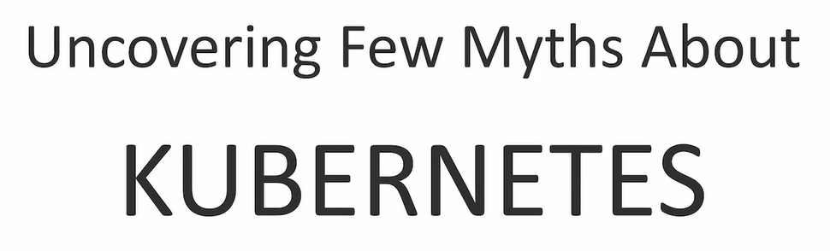

Slide 12
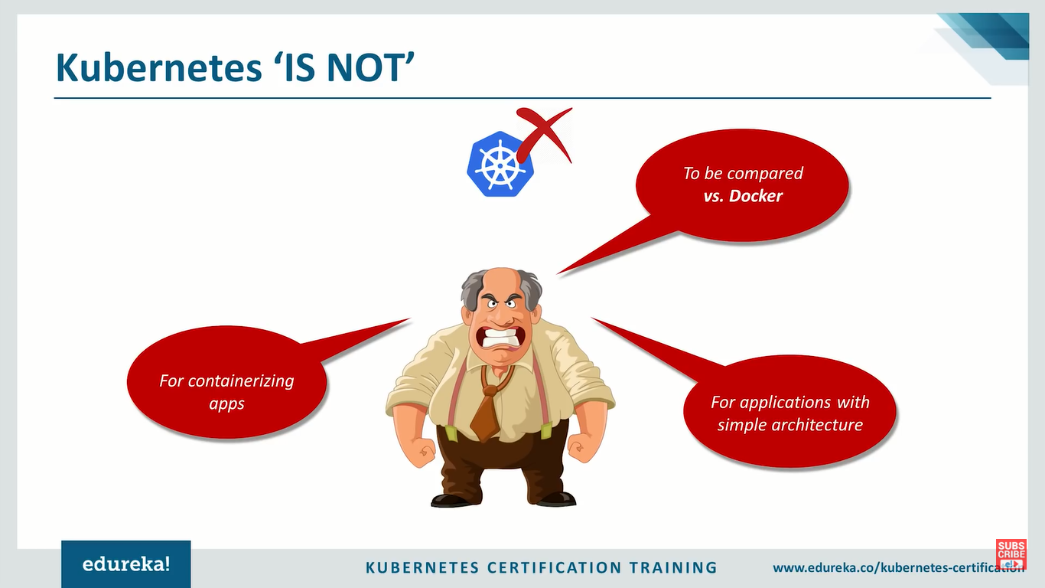
Kubernetes ‘IS NOT’

Slide 13
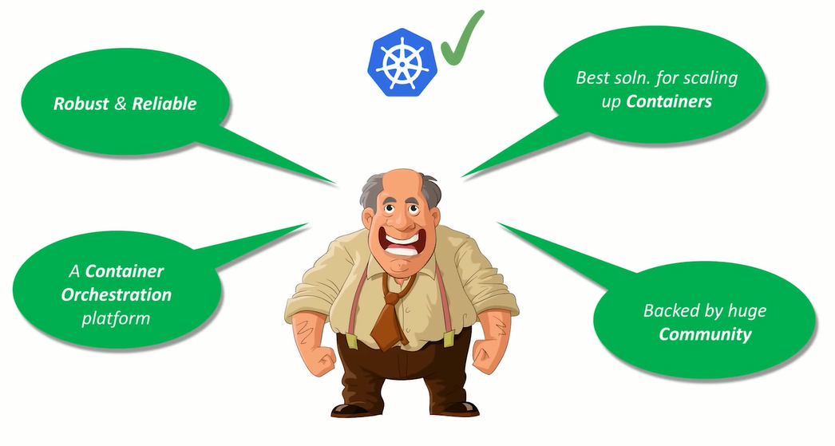
Kubernetes ‘ACTUALLY IS’

Slide 14
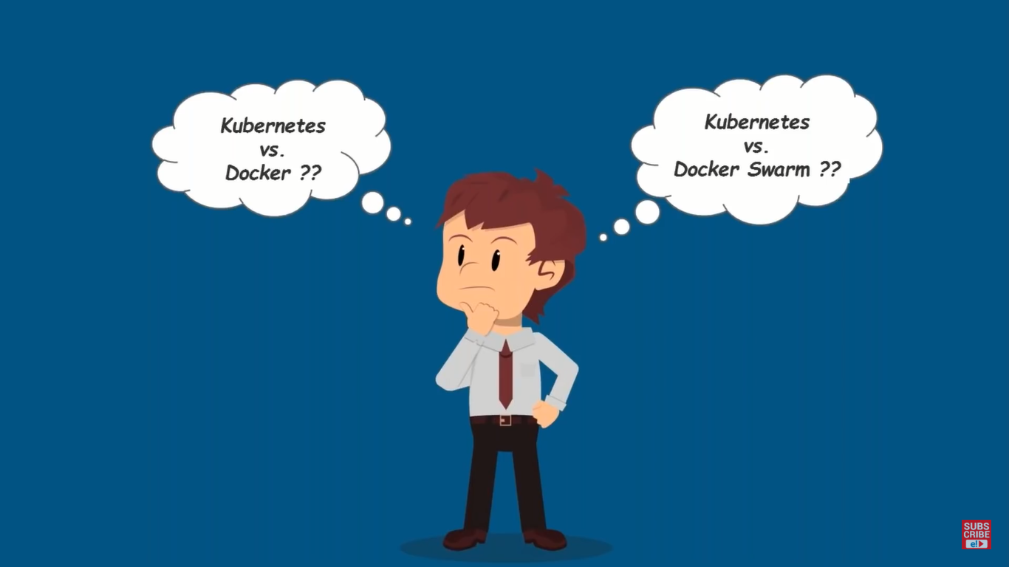

Slide 15
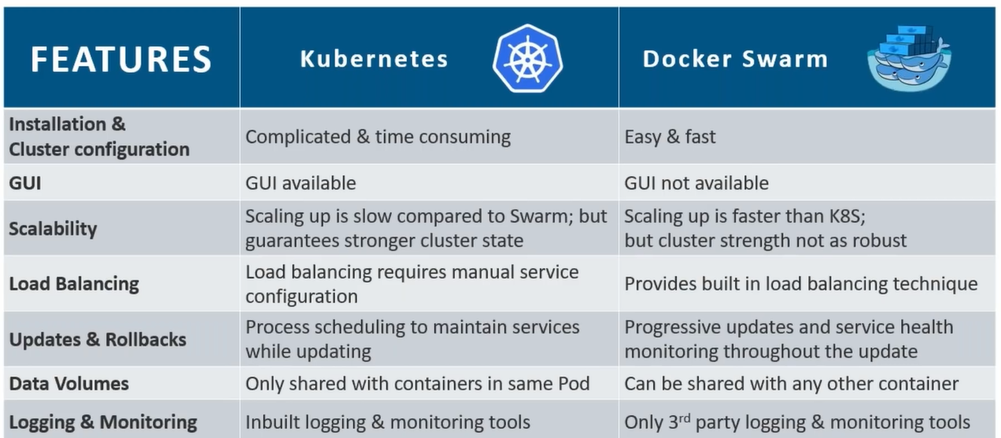
Kubernetes vs. Docker Swarm

Slide 16
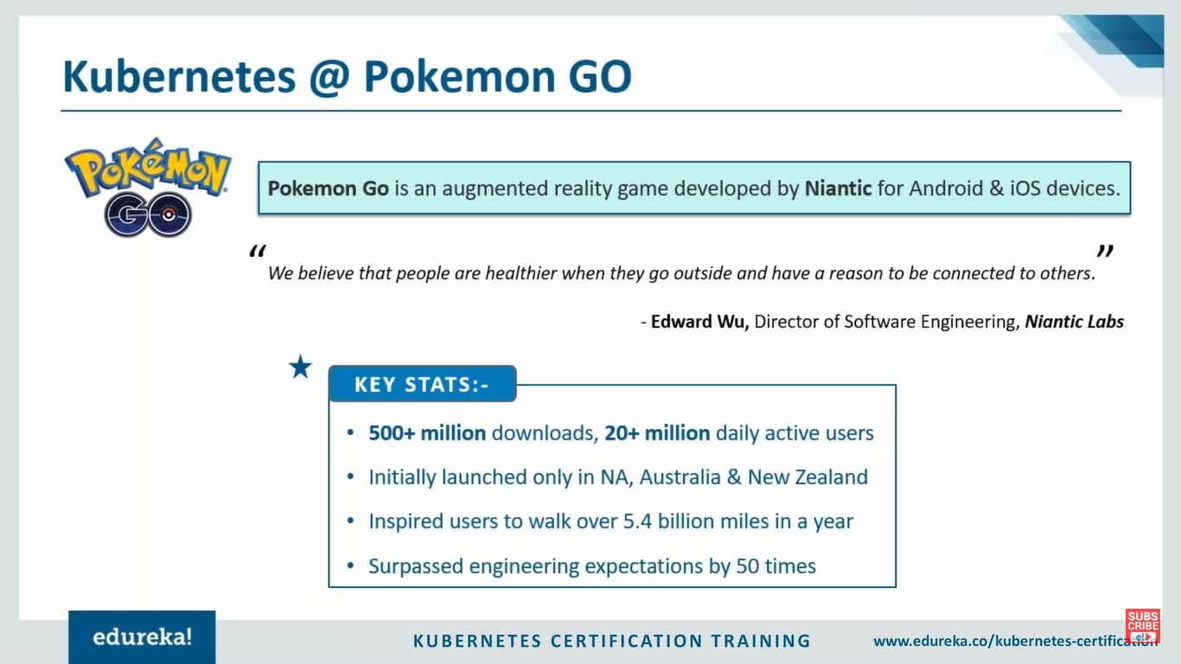
Kubernetes @ Pokemon GO

Slide 17
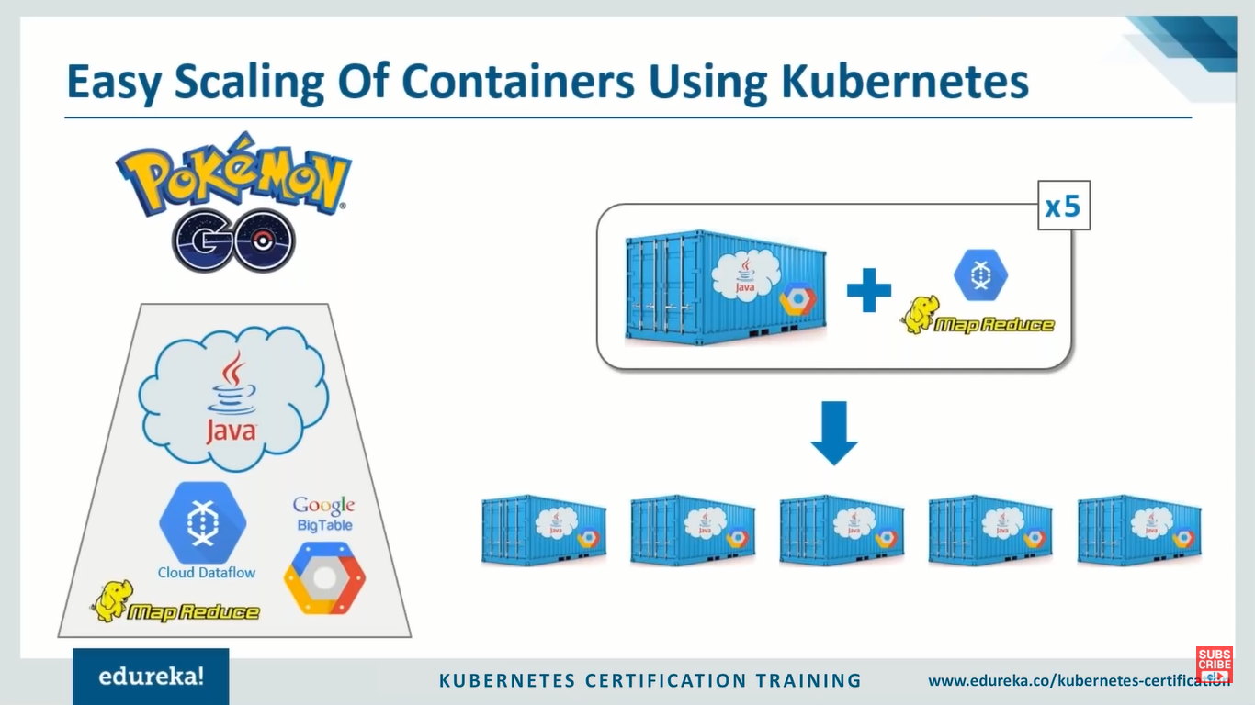
Easy Scaling of Containers Using Kubernetes

Slide 18
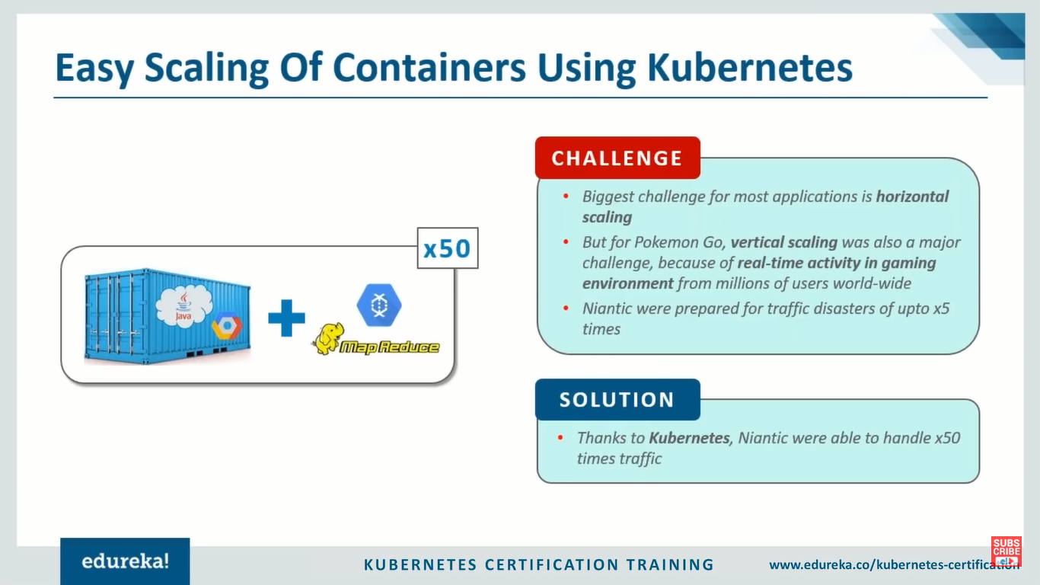
Easy Scaling of Containers Using Kubernetes

Slide 19
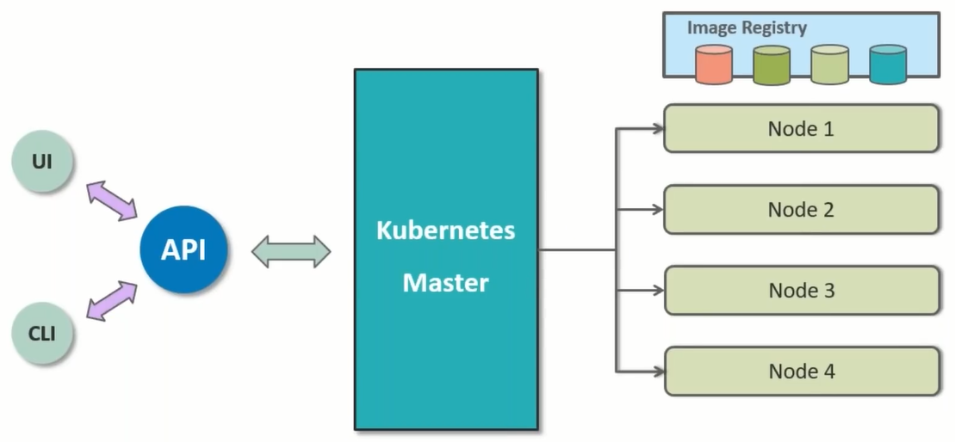
Kubernetes Architecture

Slide 20
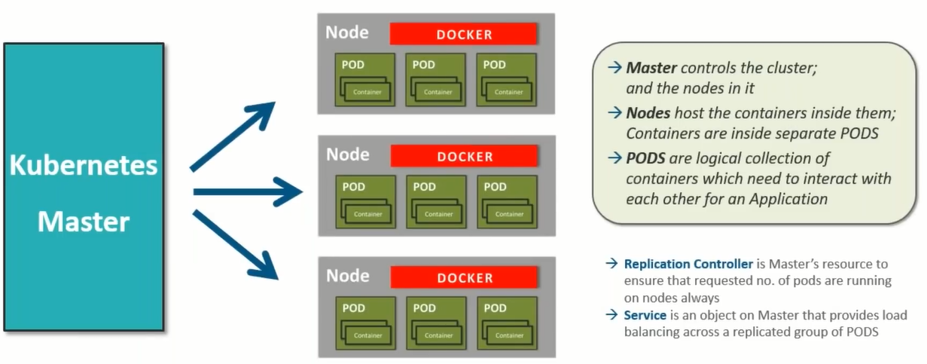
Working of Kubernetes

Slide 21
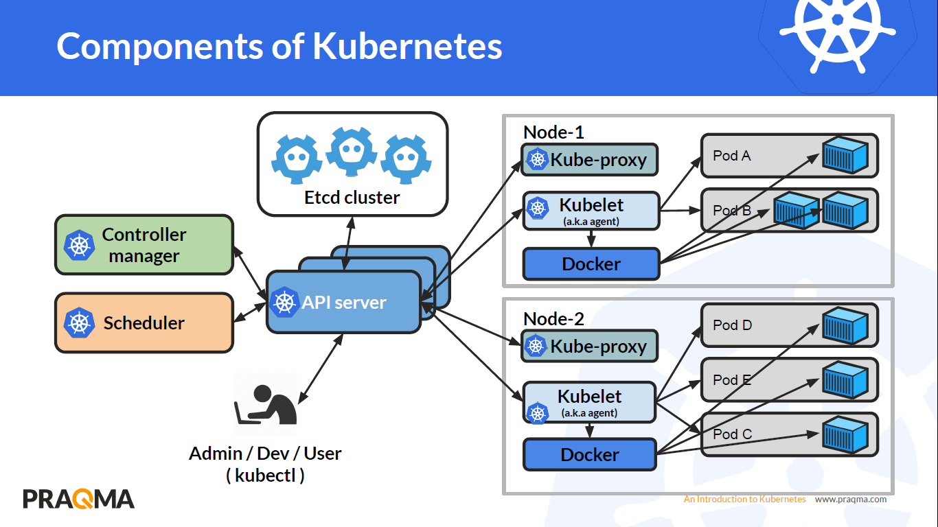
Kubernetes Components

Slide 22
Kubernetes Components
Etcd: key/value backing store for cluster data
API server: The front-end for the Kubernetes control plane. It is designed to scale horizontally.
Scheduler: Watches newly created pods that have no node assigned, and selects a node for them to run on.
Scheduling decisions include resource requirements, hardware/software/policy constraints, affinity and anti-affinity , etc.
Controller manager: Runs various controllers to help move running state to desired state.
Node Controller: Responsible for noticing and responding when nodes go down.
Replication Controller: Responsible for maintaining the correct number of pods for every replication controller object in the system.
Endpoints Controller: Populates the Endpoints object (i.e, joins Services & Pods).
Service Account & Token Controllers: Create default accounts and API access tokens for new namespaces.
Kubelet: It makes sure that containers are running in a pod.
Kube-proxy: Provides Kubernetes service abstraction by maintaining network rules on the host and performing connection forwarding.

Slide 23
Thank you!
Any Questions???

